Slide 1
Setting up Interactive Notebook
Cover page- Number Review
Contents page
Glossary
Rule up Cornell notes taking for 4 lessons

Slide 2
Place Value Review
EQ – What is the value of each digit in a number?
Mrs James
Year 11 Essentials

Slide 3

Learning Intentions
Students will be able to
use place value to read, represent and order numbers
WICOR

Slide 4
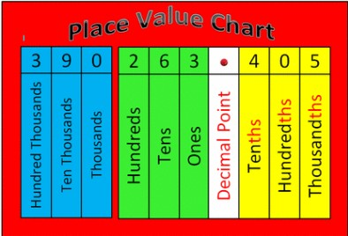
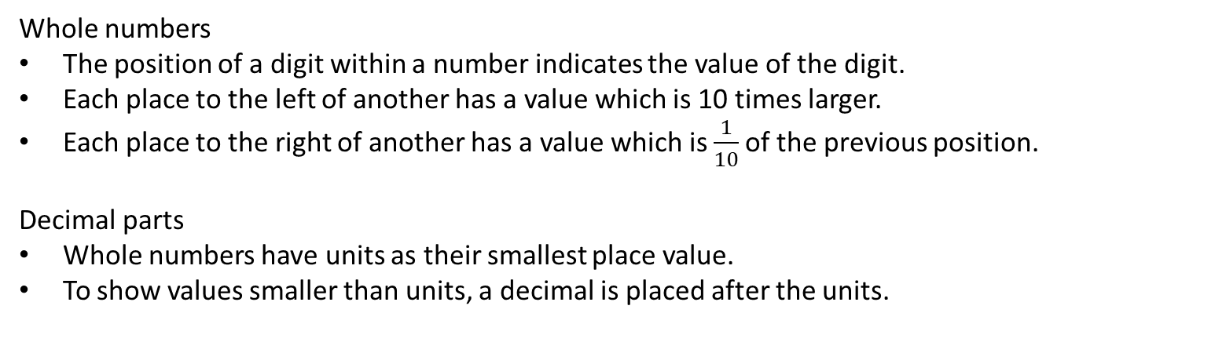
24
7
30
Place Value Review
Date:
EQ – What is the value of each digit in a number?
Whole numbers
The position of a digit within a number indicates the value of the digit.
Each place to the left of another has a value which is 10 times larger.
Each place to the right of another has a value which is $\frac{1}{10}$of the previous position.
Decimal parts
Whole numbers have units as their smallest place value.
To show values smaller than units, a decimal is placed after the units.
Question

Slide 5


Slide 6

Practice
1. In the following numbers, look at the value of the 3.
Number | Value of 3
132
3217
4103
2.
Notes:
Guide students through the question.
Option 2: Dot plots handout (Scaffolded for kids who may need extra help)

Slide 7
24
7
30
Place Value Review
Date:
EQ – How do I compare the size of decimal numbers?
To compare the size of decimal numbers first compare the whole number part.
If they are the same for each number, move to the ﬁrst digit after the decimal point, then the second, the third and so on until the digits are different.
The larger digit will belong to the larger number.
Question

Slide 8
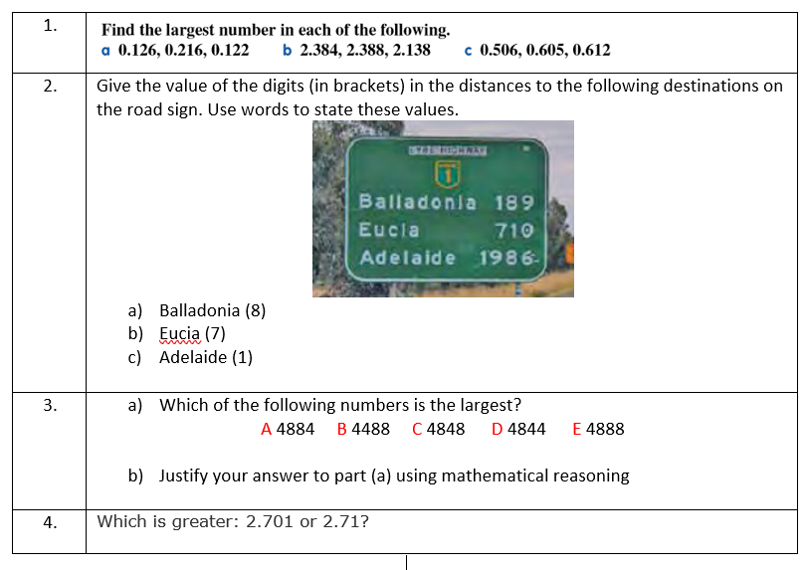
Practice

Slide 9
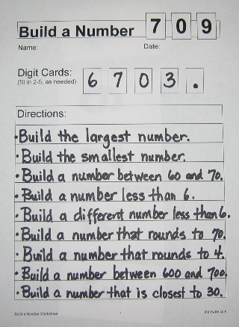
Task
Make yourself number cards (0-9 and decimal point) with blank paper
Using the 9 directions(below) and the number cards 6, 7, 0, 3 and create 9 numbers
Notes:
Guide students through the question.
Option 2: Dot plots handout (Scaffolded for kids who may need extra help)

Slide 10
Your turn
In pairs select 2-5 number cards and write 9 directions on a blank “Build a number” sheet. You will be swapping with another pair

